Slide 1
Transitioning to Team–Based Care in Behavioral Health
Case Study from the University of New Mexico
Jeff Katzman, MD Vice Chair - Department of Psychiatry & Behavioral Sciences University of New Mexico/Health Science Center School of Medicine

Slide 2
Outline
Situation Analysis
    Social determinants
    Economic pressures
    Where started from at UNM
Change Management
    Leadership
    Communication
Team-Based Approach
    Theory
    Practice & Tools
Impact

Slide 3
Behavioral Health: The Safety Net of Safety Nets
Safety net hospitals serve patients with the most limited financial resources
This population is more likely to suffer from addiction and mental illness in addition to medical health challenges
They lack the resources to secure preventative mental health care
When patients arrive at our hospital, they are in crisis
Rates of addiction and mental illness are increasing
High no show rates for appointments
Long waiting lists for outpatient services

Slide 4
Complex Coordination is the Norm
Medical
Practitioners, RN’s
PATIENT
Consulting Specialists
Psychiatrist
Case Manager
In patient
Rehabilitation Clinic
Social Services
Treatment Center
Out patient

Slide 5
Critical Shortage of Mental Health Providers
Notes:
New Mexico is the epicenter of a national shortfall of mental health providers. In simple terms, demand greatly outpaces supply.
Community resources have closed, driving waves of patients into main hubs like UNM.

Slide 6
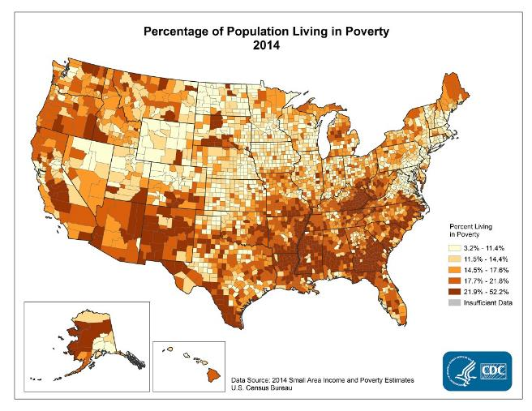
Percent of Population living below Poverty Line

Slide 7
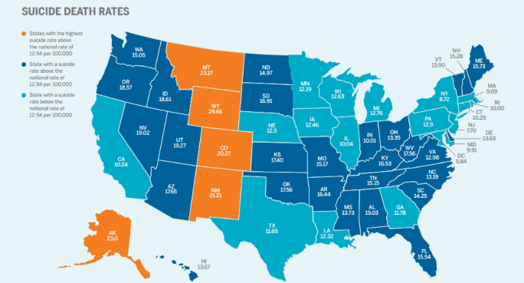
Suicide Death Rates

Slide 8
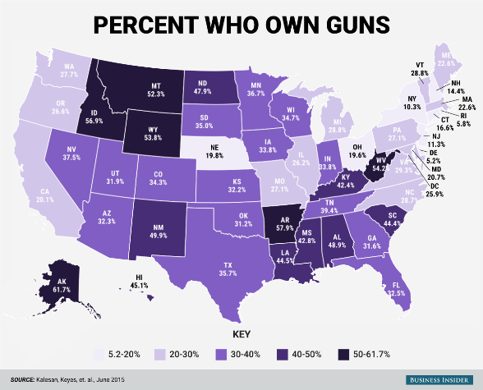
Gun Ownership by State

Slide 9
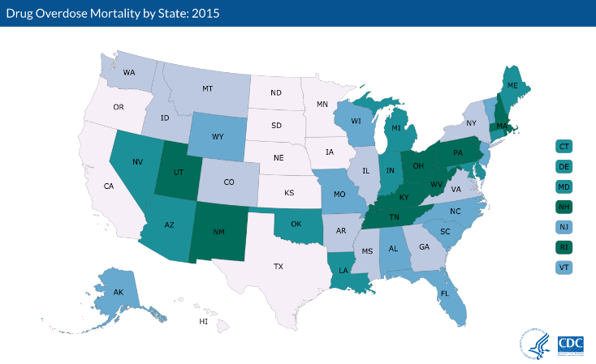
Drug Overdose Mortality

Slide 10
Behavioral Health Programs - UNM
Psychiatric Emergency Room Staffed 24/7 with resident & faculty member
Urgent Care Center
COPE—Program for 1200 Patients with SMI with embedded Primary Care
Affective Treatment Program – 1200 Patients
Psychosocial Rehabilitation Program
Community Outreach Division
Programs and fellowships in Geropsychiatry, Psychosomatics, Addictions
Substance Abuse Program with 400 patients on methadone
Forensic Liaison Programs
42 residents, Med School Class 120

Slide 11
Facilities / Patient Encounters
47 Adult Beds
35 Child Beds
1,500 Adult Admissions
800 Child Admissions
101,000 Adult outpatient encounters
25,000 Child outpatient encounters
Community Support Services Program with 200 clients and a Community ACT Team with 75 clients.
2500 outpatient adult clients in all our programs combined.

Slide 12

Where We Started From
Multiple prior year attempts to improve or address significant quality and safety concerns and operational inefficiencies with little traction or success
Deeply entrenched silos and “tribalism”
Culture of disrespect and individualism
Difficult recruitment and retention of RN’s: 50 travelers required just to keep operating rooms open
Culture of finger-pointing and blame
No real cooperation or communication among key stakeholders

Slide 13
Plotting a New Course to Coordinated Care
Conflicting Silos
One Integrated Team
Out
Patient
MDs
Clerks
LoboWings
In
Patient
Nurses
Residents

Slide 14





Using Crew Resource Management
Team-based decision making and communication procedures for high risk, high variable work.
“We share a common system for how we handle situations. It’s part of the culture here. And it’s transparent.”
“Do it my way.”
Notes:
Used an approach we had success with in our Surgery department….where X, Y and Z results were had.

Slide 15
Change Management: Top Down, Bottom Up
Department head level buy-in. Leadership must set the example and walk the talk.
PARTICIPATION
MANDATORY
Department Chairs
Nurses
Physicians
Case managers
Clerks
Everyone has a say.
They’re engaged,
not just listening.
Security

Slide 16
CRM Implementation Process
Leadership Development Institute
Teamwork Training
Communication
Training
Hardwire Safety Tools
Steering Committee-
Daily Huddles
Bi-Weekly Meetings

Slide 17

Call Sign: Lobo Wings

Slide 18

Hang Rothko Right
Notes:
mark rothko
driving to right side up….vertical
it’s a marketing tool

Slide 19
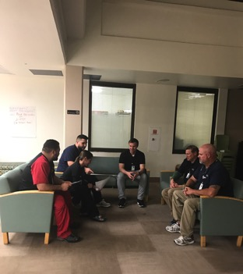
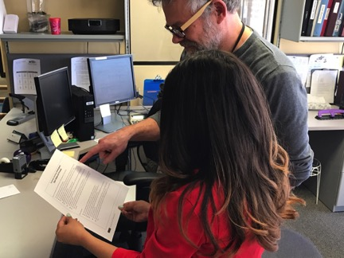
Hardwire Safety Tools – How We Did It
Daily Huddles
Psych ED to Inpatient Transfer Process
Rapid access to ASAP
Patient Checklist into Units
Resident Orientation to Rotations
Resident Intimidation Feedback
Patient Information Collection
EMTALA training
Collaborative Aggression Reduction Efficacy (CARE)
Notes:
Tools, techniques and training to turn strategy into everyday behaviors

Slide 20
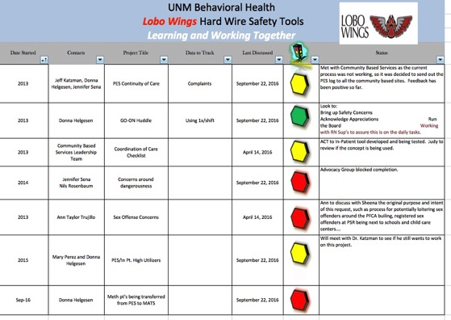
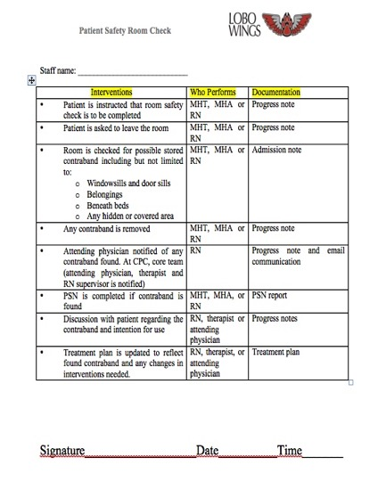
LoboWings Hardwire Safety Tools and Principles

Slide 21
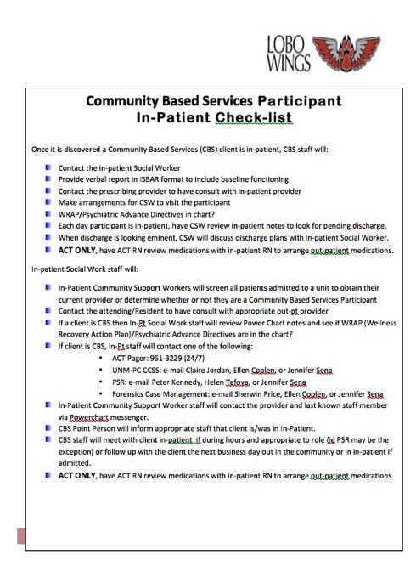
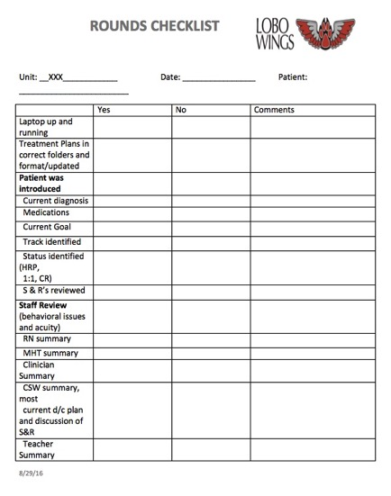
Handoff Communication Tools

Slide 22
BH Steering Committee: Evolving to Strategy
LoboWings Meetings Highly Successful, other multiple meetings lacking purpose and repetitive with unclear task
No strategic planning process in Behavioral Health Care despite multiple challenges
Evolved LoboWings into weekly Behavioral Health Strategy Meetings with similar tone
Created seven workgroups looking at different areas of Behavioral Health Care
Multiple funding opportunities then disappointments – strategic planning has remained intact because of relationships developed

Slide 23
Waiting Time – Multi-Clinic effort
Required phone call contact with clinic and started reminder call system
Limited demographics of entrance to clinic
Contacted waiting list and eliminated those in care already
Hired mid-levels to take new capacity
Worked to move people through clinic who had other providers
Worked with therapists regarding RVU education

Slide 24
What’s Been the Payoff?
Decreased addiction waiting time from one year to same day access
Physician engagement story
Development of primary care program for SMI population
Decreased waiting time from many months to one week in outpatient Behavioral Health clinic
Development of team approach to care in multiple areas
Integration of child services in Psychiatric Emergency Room
Notes:
“Working together” has led to multiple accomplishments

Slide 25
What’s Been the Payoff?
Decreased use of restraints/seclusion inpatient units through trauma informed care model
Submission of multiple grants, latest for increased care coordination
Development of post incarceration transition programs
Increased access generally to Behavioral Health programs for additional 1000 referrals
Notes:
“Working together” has led to multiple accomplishments

Slide 26
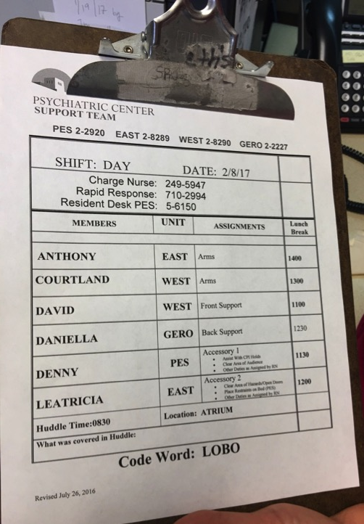
”LoboWings created a mechanism for us to get together and be much more focused. It was the vehicle that made us more accountable to each other and got us all on the same page.”
Dr. Dave Graeber
Child and Adolescent Psychiatrist
Medical Director, Child Psychiatric Hospital

Slide 27
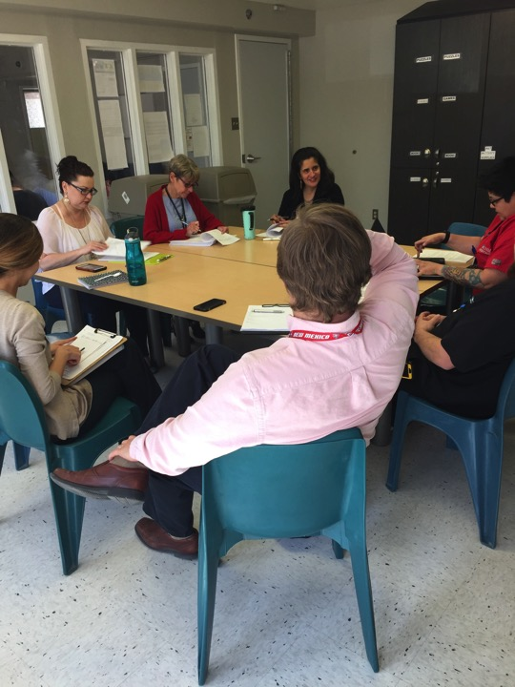
“It’s hard to even describe how much better the environment is here now without having worked in it prior. “
Dr. Shannon Stromberg
Medical Director, UNMPC Inpatient Services
Attending Psychiatrist, UNMPC Inpatient Units

Slide 28
Safer Working and Patient Environment
Seclusions and restraints ⬇22%
Staff assaults ⬇75%
Notes:
22% decrease in our seclusion and restraints since December of 2011 to december of 2016, which was the year prior to Lobowings starting at UNMH.
75% decrease overall in assaults from December of 2014 to December of 2016 using huddles, debriefings, as well as implementing patient rounding and a recovery base model of care.

Slide 29
Staff Satisfaction Way Up*
People support one another ⬆26%
We’re working as a team ⬆23%
I am satisfied with my job ⬆20%
*Press Gainey – Safety Culture Report
Notes:
Improvements 2013-2015 from safety culture reports in Pysch and ED

Slide 30
Direct Value to Bottom Line
OP Volume⬆10-15%
Wait Times
⬇80%

Slide 31
Patient Satisfaction Breakthroughs*
In-Patient Overall Satisfaction
⬆62%
Out-Patient Overall Satisfaction
⬆66%
*Press Gainey Patient sat report
Notes:
improvement in overall patient satisfaction from 2010 - 2016

Slide 35
The Journey is Never Over
Collapse of surrounding Mental Health services
Increased pressure on Emergency Services
Waiting times growing
Expanding model to multiple stakeholder groups
  City, County, State collaborations

Slide 36
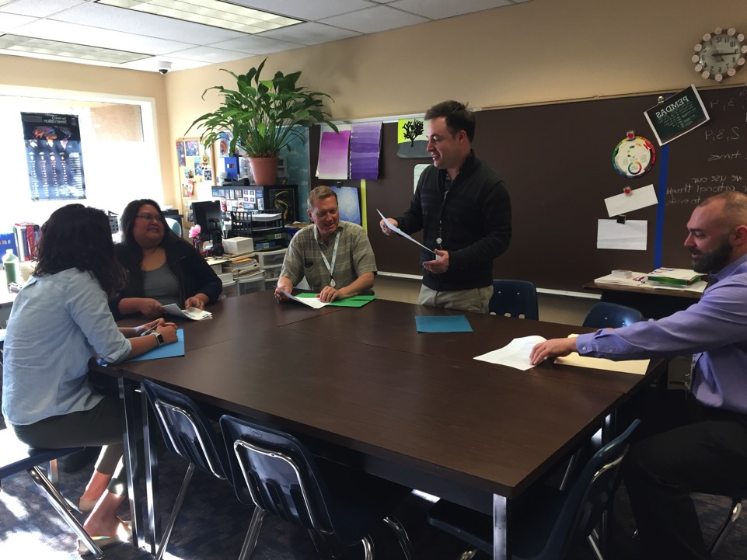
What Questions Do You Have?

